Slide 1




Cryptographic
Concepts

Slide 2
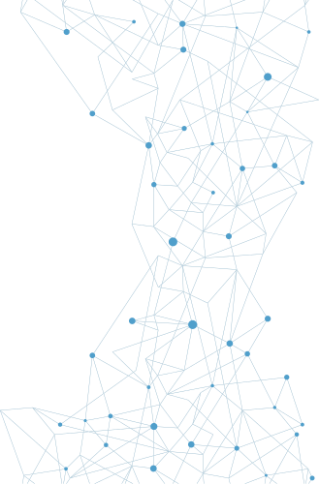

Cryptography
Cryptography is the science of encrypting, or hiding, information— something people have sought to do since they began using language. Although language allowed them to communicate with one another, people in power attempted to hide information by controlling who was taught to read and write.

Slide 3
General
Cryptographic Concepts
Historical ciphers were simple to use and also simple to break.
A famous example of a modern encryption machine is the German Enigma machine from World War II.
When material, called plaintext, needs to be protected from unauthorized interception or alteration, it is encrypted into ciphertext. This is done using an algorithm and a key, and the rise of digital computers has provided a wide array of algorithms and increasingly complex keys.

Slide 4
Fundamental
Methods
Modern cryptographic operations are performed using both an algorithm and a key. The choice of algorithm depends on the type of cryptographic operation that is desired. The subsequent choice of key is then tied to the specific algorithm. Cryptographic operations include encryption for the protection of confidentiality, hashing for the protection of integrity, digital signatures to manage nonrepudiation, and a bevy of specialty operations such as key exchanges.

Slide 5
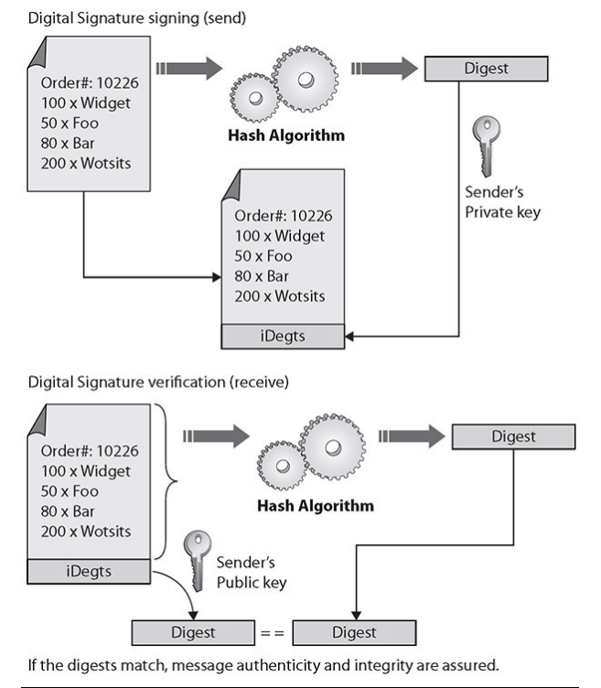
Digital
Signatures
A digital signature is a cryptographic implementation designed to demonstrate authenticity and identity associated with a message. Using public key cryptography, a digital signature allows traceability to the person signing the message through the use of their private key. The addition of hash codes allows for the assurance of integrity of the message as well.

Slide 6
Key
Length
The strength of a cryptographic function typically depends upon the strength of a key, where a larger key has more entropy and adds more strength to the encryption. Because different algorithms use different methods with a key, direct comparison of key strength between different algorithms is not easily done. Some cryptographic systems have fixed key lengths, such as Triple Digital Encryption Standard (3DES), while others, such as Advanced Encryption Standard (AES), have multiple lengths (for example, AES-128, AES-192, and AES-256).

Slide 7
Key
Stretching
Key stretching is a mechanism that takes what would be weak keys and “stretches” them to make the system more secure against brute-force attacks. As computers have gained computational power, hash functions can be computed very quickly, leading to a need for a manner of increasing the workload when computing hashes; otherwise, an attacker can merely compute them all. In the case of a short key, the chance of randomly matching the hash function by use of computational guessing attacks has increased.

Slide 8
Salting
To provide sufficient entropy for low-entropy inputs to hash functions, a high-entropy piece of data can be concatenated with the material being hashed. The term salt refers to this initial data piece. Salts are particularly useful when the material being hashed is short and low in entropy. The addition of a high-entropy (say, a 30-character) salt to a three-character password greatly increases the entropy of the stored hash.

Slide 9
Hashing
A hashing function is a special mathematical function that performs one-way encryption, which means that once the algorithm is processed, there is no feasible way to use the ciphertext to retrieve the plaintext that was used to generate it. Also, ideally, there is no feasible way to generate two different plaintexts that compute to the same hash value.

Slide 10
Hashing
Common uses of hashing algorithms are to store computer passwords and to ensure message integrity. The idea is that hashing can produce a unique value that corresponds to the data entered, but the hash value is also reproducible by anyone else running the same algorithm against the data. So you could hash a message to get a message authentication code (MAC)

Slide 11
Hashing
HMAC, or Hash-based Message Authentication Code, is a special subset of hashing technology. It is a hash algorithm applied to a message to make a MAC, but it is done with a previously shared secret. So, the HMAC can provide integrity simultaneously with authentication.

Slide 12
Hashing
A hash algorithm can be compromised with what is called a collision attack, in which an attacker finds two different messages that hash to the same value. This type of attack is very difficult and requires generating a separate algorithm that will attempt to find a text that will hash to the same value of a known hash.

Slide 13
Key
Exchange
Cryptographic mechanisms use both an algorithm and a key, with the key requiring communication between parties. In symmetric encryption, the secrecy depends on the secrecy of the key, so insecure transport of the key can lead to failure to protect the information encrypted using the key. Key exchange is the central foundational element of a secure symmetric encryption system. Maintaining the secrecy of the symmetric key is the basis of secret communications. In asymmetric systems, the key exchange problem is one of key publication. Because public keys are designed to be shared, the problem is reversed from one of secrecy to one of publicity.

Slide 14
Perfect
Forward Secrecy
Perfect forward secrecy (PFS) is a property of a public key system in which a key derived from another key is not compromised, even if the originating key is compromised in the future. This is especially important in session key generation, where future communication sessions may become compromised; if perfect forward secrecy were not in place, then past messages that had been recorded could be decrypted.

Slide 15
Quantum
Cryptography
Quantum cryptography is the use of quantum computing hardware to perform encryption and decryption processes. Quantum hardware is still in its early stages of development, and the immense computing power in these platforms will revolutionize cryptography.

Slide 16
Ephemeral
Keys
Ephemeral keys are cryptographic keys that are used only once after generation. When an ephemeral key is used as part of the Diffie-Hellman scheme, it forms an Ephemeral Diffie-Hellman (EDH) key exchange. An EDH generates a temporary key for each connection, never using the same key twice.

Slide 17
Modes of
Operation
The basic premise of operation modes is to use some source of entropy before encrypting subsequent blocks so that identical blocks of plaintext produce differing blocks of ciphertext. These modes can be broken into three groups: authenticated, unauthenticated, and counter.

Slide 18
Modes of
Operation
AUTHENTICATED
Authenticated encryption with associated data (AEAD) is a form of encryption designed to provide both confidentiality and authenticity services. A wide range of authenticated modes is available for developers, including GCM, OCB, and EAX.

Slide 19
Modes of
Operation
COUNTER
Counter mode (CTM) uses a “counter” function to generate a nonce that is used for each block encryption. Different blocks have different nonces, enabling parallelization of processing and substantial speed improvements.

Slide 20
Modes of
Operation
UNAUTHENTICATED
Unauthenticated modes use a non-identity-based source for the entropy element for subsequent blocks. In cipher block chaining (CBC), each block is XORed with the previous ciphertext block before being encrypted.

Slide 21
Blockchain
Blockchains are lists of records, where each addition to the list is done by a cryptographic algorithm.
The concept of blockchains was invented to create the public transaction ledger of cryptocurrencies. A cryptocurrency is a currency system built on a finite set of “rare” numbers that are mined and then “created.”

Slide 22
Cipher
Suites
The term cipher suite refers to a set of algorithms used together in cryptography, with the most famous being the TLS cipher suite
Block ciphers operate on input data in a series of blocks.
Stream ciphers operate on streams of data instead of blocks. Stream operations typically take place on a single byte at a time, using an XOR function and a pseudorandom key.

Slide 23
Symmetric vs
Asymmetric
Symmetric encryption tends to be faster, is less computationally involved, and is better for bulk transfers. But it suffers from a key management problem in that keys must be protected from unauthorized parties.
Asymmetric methods resolve the key secrecy issue with public keys, but they add significant computational complexity, which makes them less suited for bulk encryption.

Slide 24
Lightweight
Cryptography
Lightweight cryptography is a specialized suite of cryptographic algorithms designed to operate in this resource-constrained environment.

Slide 25
Steganography
Steganography, an offshoot of cryptography technology, gets its meaning from the Greek word steganos, meaning covered. Invisible ink placed on a document and hidden by innocuous text is an example of a steganographic message. Another example is a tattoo placed on the top of a person’s head, visible only when the person’s hair is shaved off.

Slide 26
Homomorphic
Encryption
Homomorphic encryption is a set of algorithms that allows operations to be conducted on encrypted data, without decrypting and re-encrypting. The concept is simple: create a system that allows operations on ciphertext that, when decrypted, will have the same result as if the operation was performed on plaintext.

Slide 27
Common
Use Cases
01. Low Power Devices
02. Low Latency Operations
03. High-Resiliency Systems
04. Support for Confidentiality
05. Support for Integrity
06. Support for Obfuscation
07. Supporting Authentication
08. Support for Nonrepudiation

Slide 28
Limitations
01. Speed
07. Reuse
02. Size
08. Entropy
03. Weak Keys
09. Computational Overhead
04. Time
10. Resource vs Security Constraints
05. Longevity
11. Weak/Deprecated Algorithms
06. Predictability

Slide 29
Thank
You

